Slide 1

Having Fun Fernando Kruse Andre Queiroz Lukasz_Blicharz

Slide 2
Purpose
Use a Supervised Machine Learning algoritm to suggest destinations for traveling based on historial information from customers, considering:
Previous Destination
Type of destination (beach, city, florests, etc.)
Stars (1-5)
Continent
Price
How many visites to this place
Desmonstrate interest to visit that place again
Customer Name

Slide 3
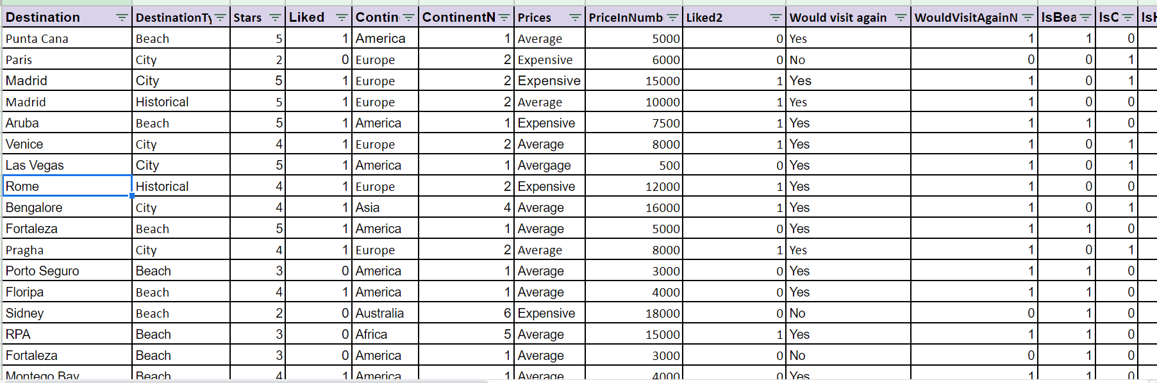
Survey
https://docs.google.com/spreadsheets/d/10dctEynoP2iGO_QGBqrBDbzPaw2h14Oyd4-yejbMAjM/edit?usp=sharing

Slide 4
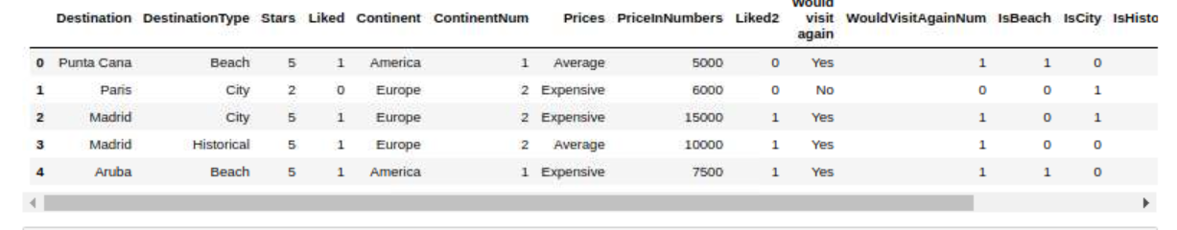
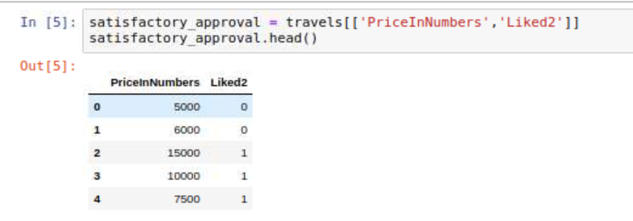

Slide 5
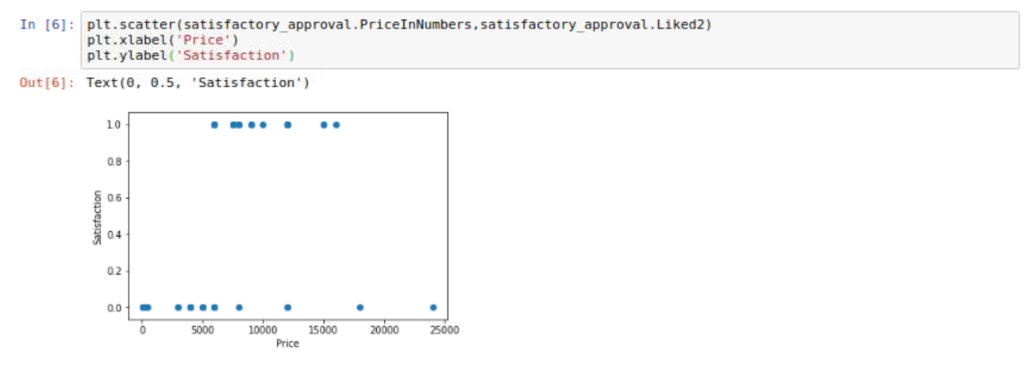
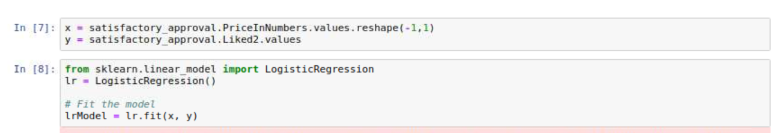

Slide 6
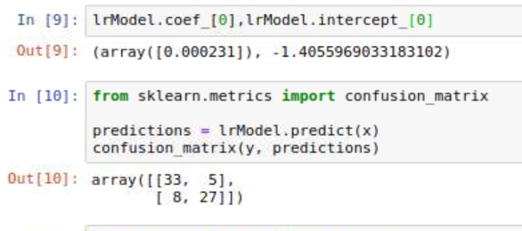
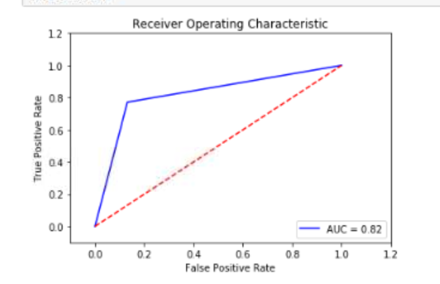

Slide 7
